Slide 1



Search Tutorial

Slide 2
1. Search Problems

Slide 3
Search Problems
Component
State space
Successor function (actions, costs)
Start state
Goal test
Solution
A sequence of actions that reaches the goal

Slide 4
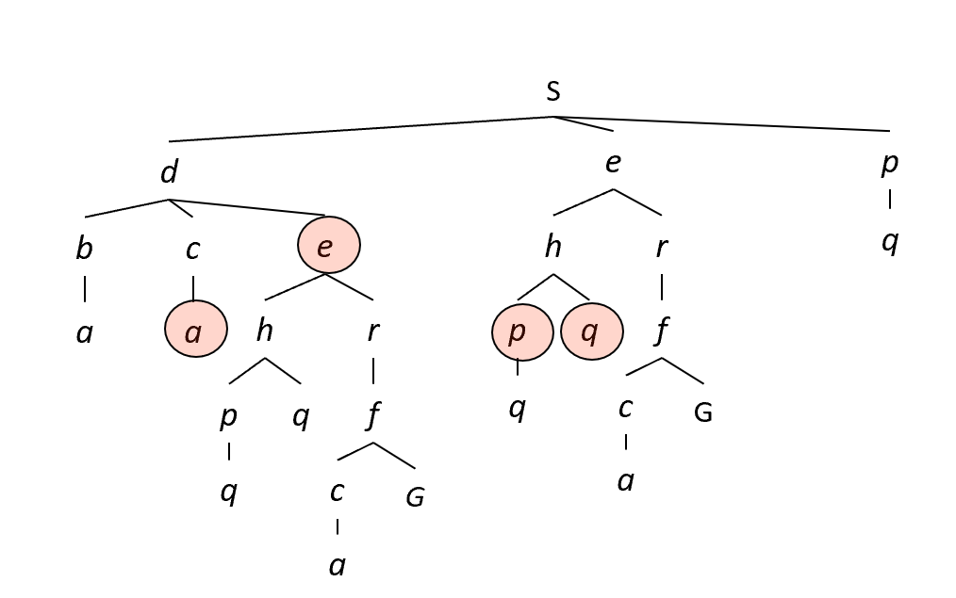
Searching for Solutions
Process
Start at the initial state from the search tree
Expand the current state (took actions, form branches, move to other nodes)
Test whether the state matches the goal configuration
Focus
Frontier: all leaf nodes available for expansion
Search strategy: how to choose next state to expand
Paradigm
Tree search
Graph search

Slide 5
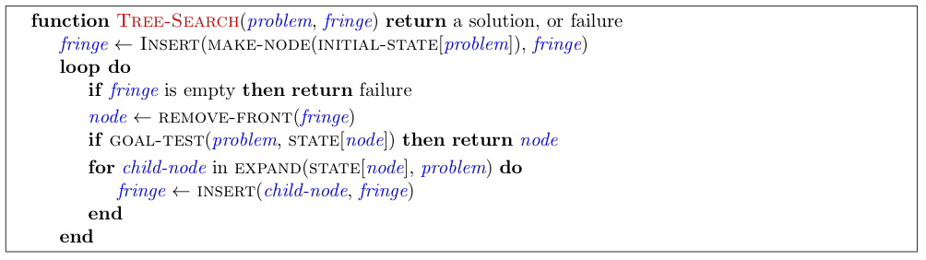
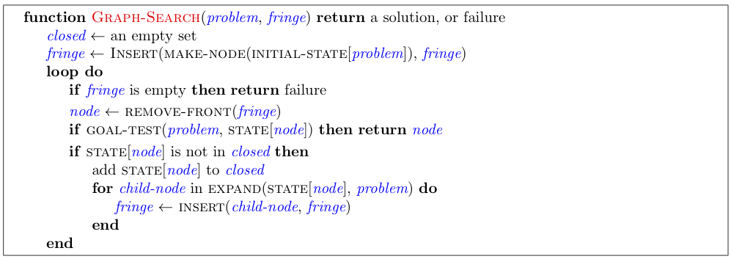
Pseudo-Code for Search Paradigm

Slide 6
2. Search Algorithm

Slide 7
Search Algorithm
Uninformed Search
Depth-first search (DFS)
Breadth-first search (BFS)
Uniform-cost search (UCS)
Informed Search
A* search

Slide 8
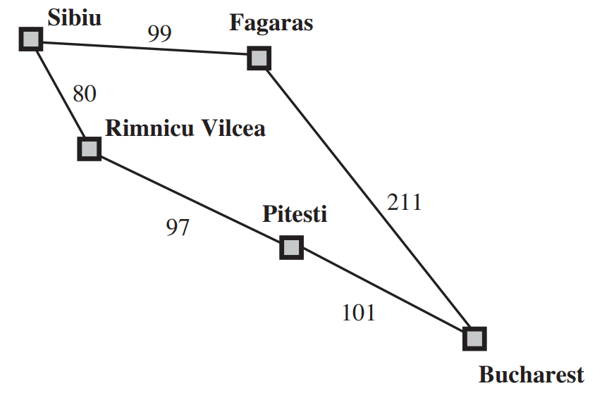
UCS
Point
Expand the cheapest node in the current frontier of the search tree
Frontier: priority queue (cumulative cost)
function UNIFORM-COST-SEARCH(problem) returns a solution, or failure node ←a node with STATE = problem.INITIAL-STATE, PATH-COST = 0 frontier ← a priority queue ordered by PATH-COST, with node as the only element explored ← an empty set loop do if EMPTY?( frontier) then return failure node ← POP( frontier) /* chooses the lowest-cost node in frontier */ if problem.GOAL-TEST(node.STATE) then return SOLUTION(node) add node.STATE to explored for each action in problem.ACTIONS(node.STATE) do child ← CHILD-NODE(problem, node, action) if child.STATE is not in explored or frontier then frontier ← INSERT(child, frontier) else if child.STATE is in frontier with higher PATH-COST then replace that frontier node with child
?
?
Notes:
goal test 发生在节点被选择扩展时（查找子结点之前）：第一个生成的目标结点可能在次优路径。
如果frontier中有更好的路径到达该结点则会引起一个goal test。
99+211=310
80+97+101=278

Slide 9
3. Data Structure

Slide 10
Data Structure
PUSH
POP
Utilized in Search Problem
Stack
Queue
Priority queue
Features in Common
pop() / dequeue(): delete operation
push() / enqueue(): add items
isEmpty(): check whether the data structure contains items
Flexible size
FRONT
REAR
TOP
{item}
{item}
{item}
{item}
{item} | {item} | {item} | {item}
DEQUEUE
ENQUEUE
Notes:
stack 叠盘子 先取走上面的
queue 排队进门 排在前面的先进去

Slide 11
Priority Queue
class PriorityQueue:
def __init__(self):
self._elements = []
self._size = 0
def is_empty(self):
return self._size == 0:
def enqueue(self, e):
self._elements = self._elements + [e]
self._size += 1
def dequeue(self):
if self.is_empty():
raise Exception(“PriorityQueue underflow!")
prior_index = 0
for i in range(self._size):
if self._elements[i]<self._elements[prior_index]:
prior_index = i
e = self._elements[prior_index]
self._size -= 1
self._elements = self._elements[:prior_index]
+self._elements[prior_index+1:]
return e
def get_size(self):
return self._size
Extension of Queue
An element with high priority is dequeued before an element with low priority.
If two elements have the same priority, they are served according to their order in the queue.
External module
heapq
Notes:
https://docs.python.org/zh-cn/3/library/heapq.html

Slide 12

4. Python Implementation

Slide 13

Debug
Break point
F7 (Step into)
F8 (Step Over)
F9 (Resume)
Monitor variable
Make good use of test_for_debug.py

Slide 14
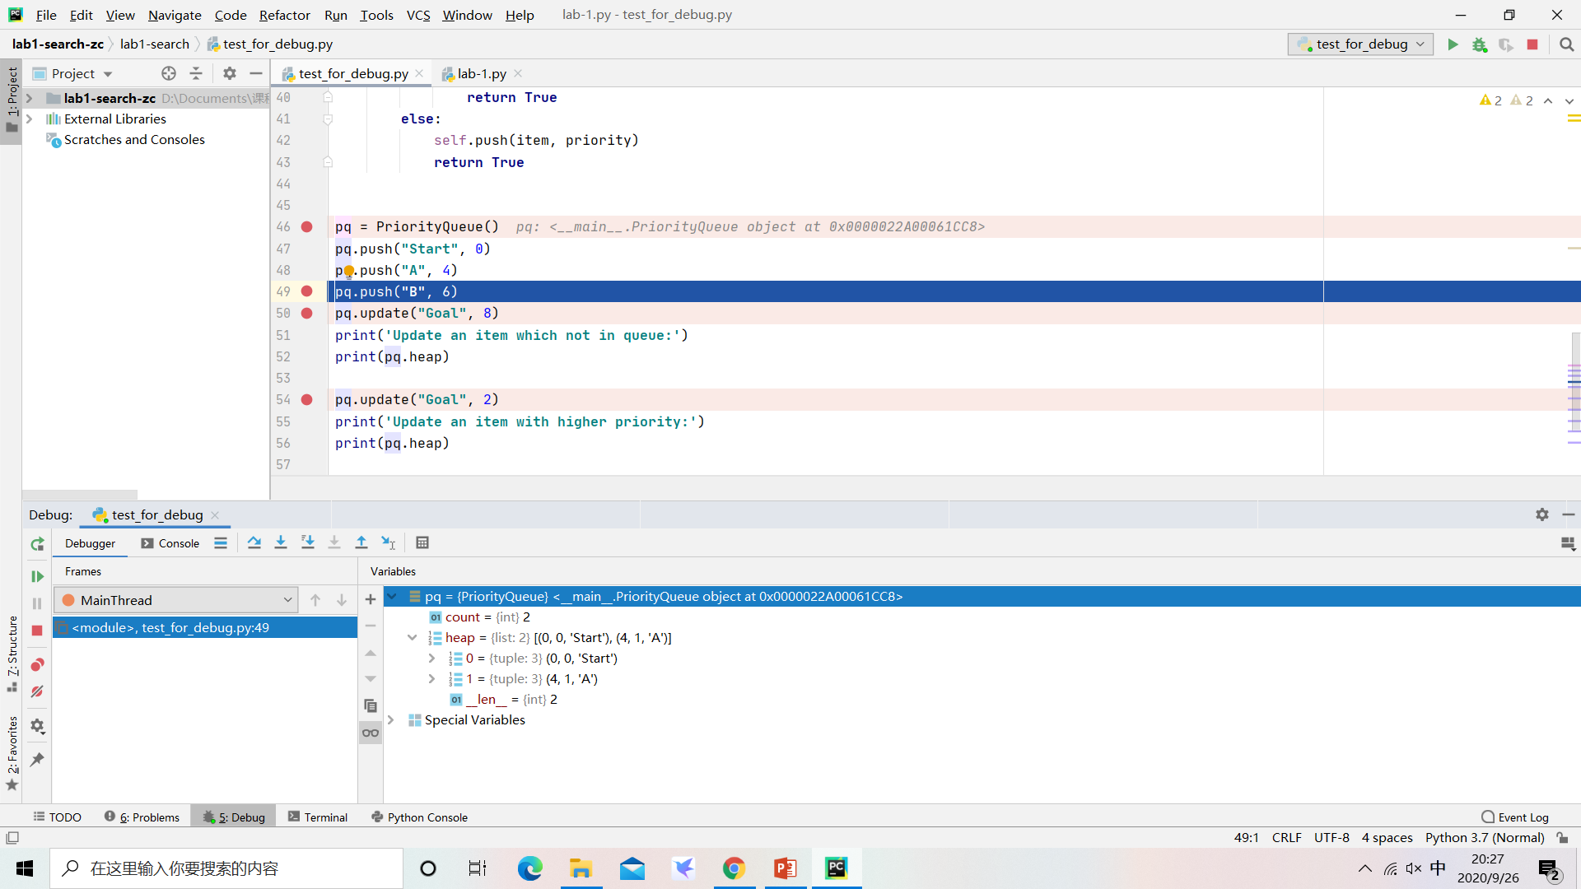
Debug
variable

Slide 15

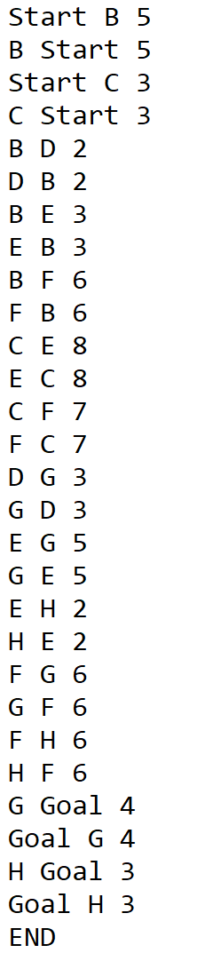
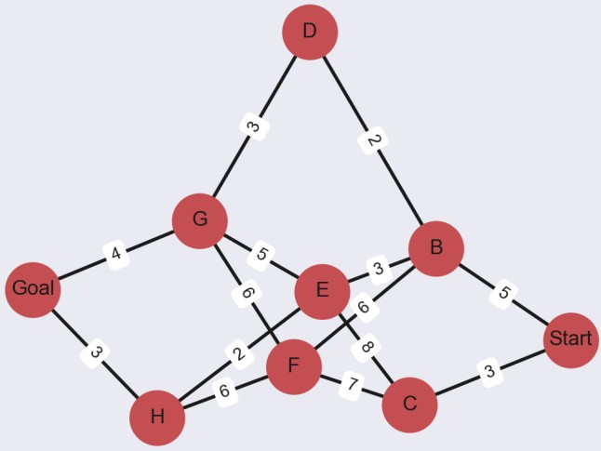
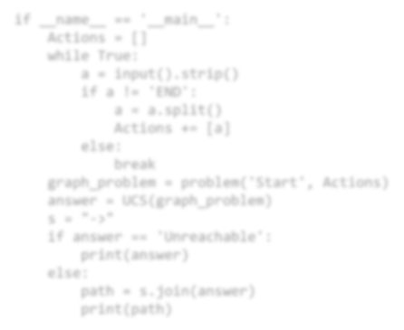


I/O
Input
testcases --> “input(num).txt”
if name == ' main ':
Actions = []
while True:
a = input().strip() if a != 'END':
a = a.split() Actions += [a]
else:
break
graph_problem = problem('Start', Actions) answer = UCS(graph_problem)
s = "->"
if answer == 'Unreachable': print(answer)
else:
path = s.join(answer)
print(path)
Output
testcases --> “output(num).txt”

Slide 16
Code Logic
PriorityQueue
Data Structure
problem
search actions: given a node, return possible actions
solution: return a list containing nodes in optimal path
transition: given a state and specific action, return next state
goal test: given a node, return whether the node matches the goal
step cost: given inherited nodes and action, return step cost
child node: given a node and specific action, return child node
UCS(problem)
implement the search process

Slide 17
OJ
http://10.192.9.82
Register with your ID
Test on your own

Slide 18
Lab for Search
Task
Implement Uniform-Cost Search in Python
Time limits: 2000 ms
Pass the test to get the full score! (as participation grade)
DDL
Environment
http://10.192.9.82
Python 3
Suggest using Pycharm to test (automatically identify line break)

